Slide 1

NUTAN COLLEGE OF ENGINEERING AND RESEARCH
DEPARTMENT: ARTIFICIAL INTELLIGENCE
PROJECT BASE: WEB APPLICATION
coordinator: Dr Sagar Shinde sir
PREPARED BY: 1. PRATHAMESH SURYAVANSHI
2. PRATIKSHA KUDE

Slide 2

Title: A footprints towards emerging India Purpose: Help India to emerge in a new manner

Slide 3

A footprints towards emerging India

Slide 4

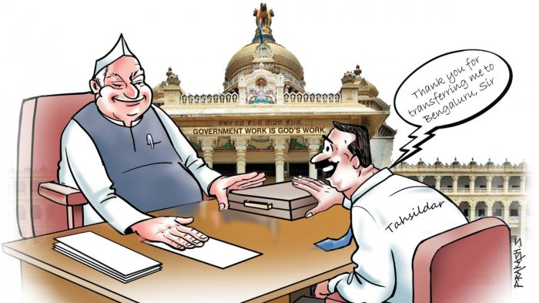
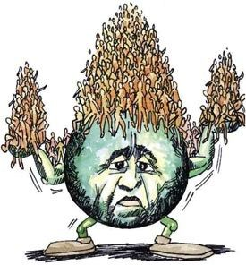
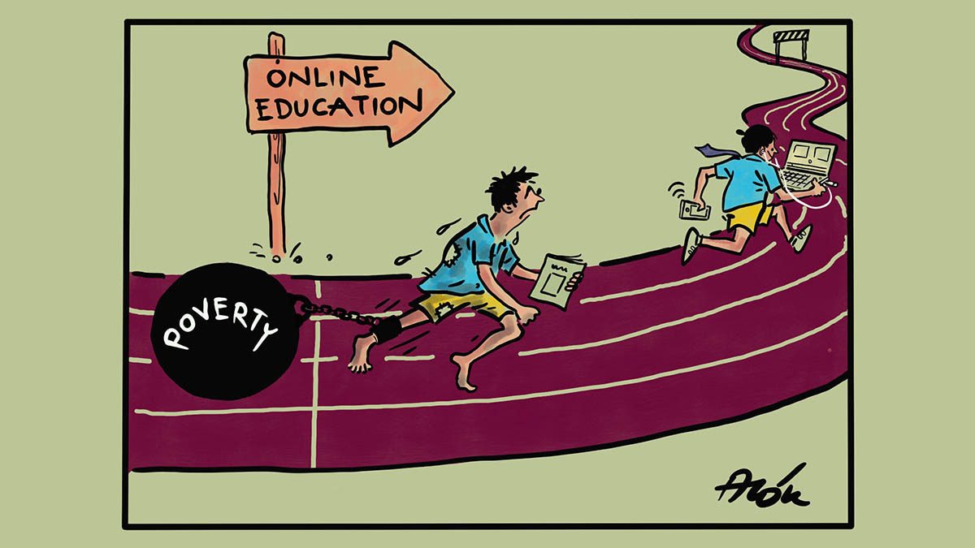
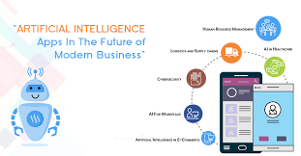
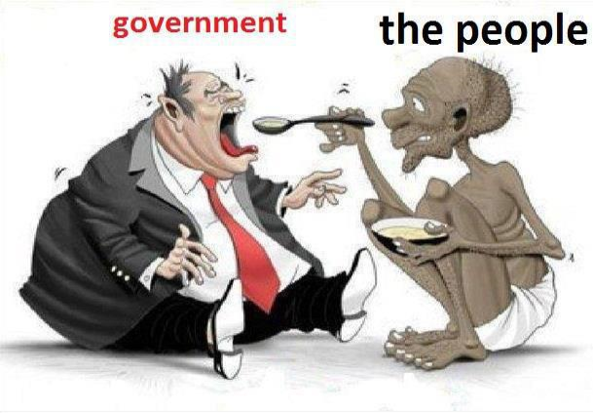
After 73 years too, India is still lagging in technologically Why? Why? Why?
Is it Increment in population stopping India?
Is it politics that stops the overall growth of India?
Is our Education sector need to be improved?
Or Do we lack in Research /Technology?
Or the Poor people/Naxalism/Minority is increasing?

Slide 5
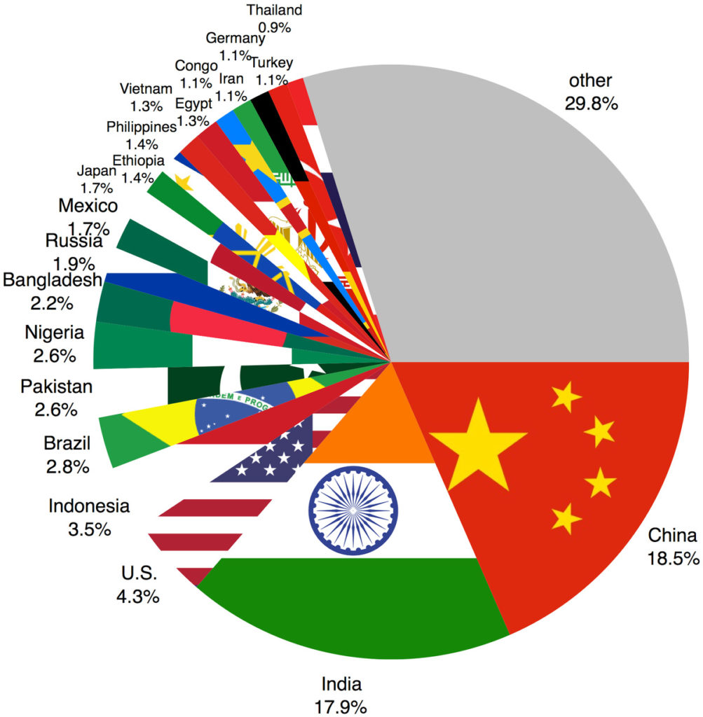
Increment in Population?
Over-population
Unemployment Global Warming Pollution
Key Points where Gov. is taking steps:
Decrement in Maternal rate
Ending curable infant mortality

Slide 6
Conclusion: {For reducing population}
SO What we will do?
Solution:
Social Measure: Minimum age , raising status of women etc.
Economic Measure: More employment opportunities, development of agriculture and industry
Other Measure: employment to women
Change in fertility rate i.e. 2:2 2:1 (which is followed by China)

Slide 7
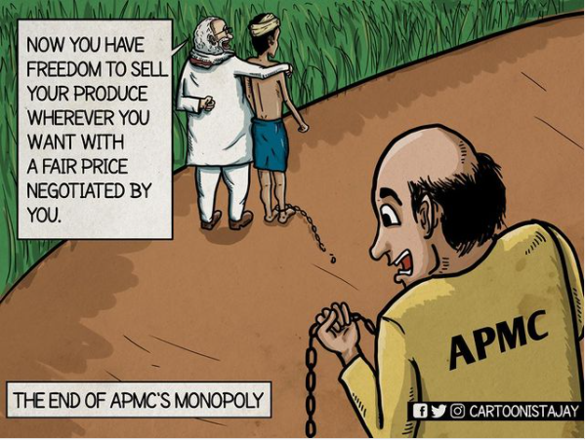
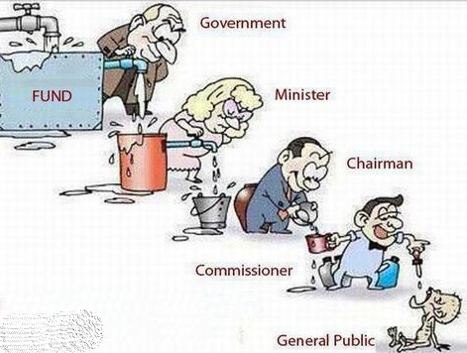
Is it the politics that stops the overall growth of India?
POLITICS
CORRUPTION UNEDUCATED MINISTER
What Gov. did to resolve this :
Replaced 60 ministers
Removed uneducated ministers
Changed farm bills

Slide 8

Conclusion: { what to do to politics}
Replace the uneducated ministers with the educated minister
Instead of one minister on they should appoint two ministers (experienced + young)
Removing garbage
Increasing salary of employees according to their work
Network marketing

Slide 9


Is our Education sector needs to be improved?
Education
Why Education is important?
What Actions should be taken to make education better?
How Education is different in other countries?
What Gov. Planned:
They Changed the Education Policy i.e. 10 + 2 5 + 3 + 3 + 4
Introduced a lot of schemes

Slide 10

Conclusion: { improve education}
Instead of theoretical knowledge giving practical knowledge
English language should be made compulsory{in new policy}
As 3% 4% of total GDP but , should be implemented fast

Slide 11

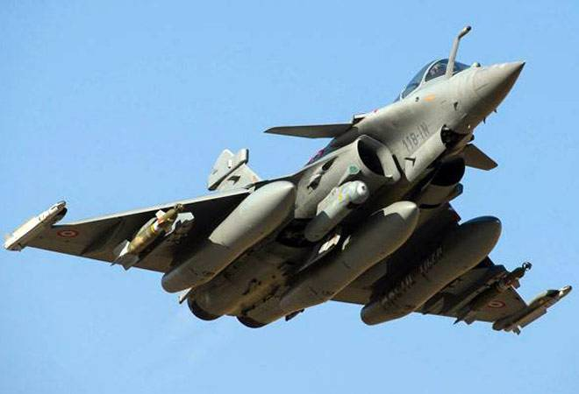
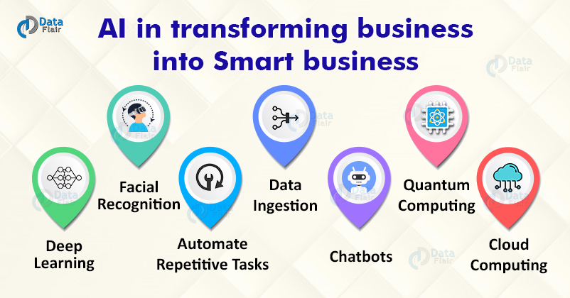
Research and Technology
India has many institutes for e.g. DRDO, IISER,ISRO etc
Education + Technology = Developed INDIA
What GOV. did to increase the Technology:
Indo-US Science and Technology Forum(IUSSTF) agreement
Deal of Rafael from France
Introduction of AI
e.g. Sofia the first Indian robot

Slide 12


Conclusion : {use of technology}
Indian’s are best planners {should be given practical knowledge with the help of AI}
Use of AI in agriculture
E.g. Tacoma public school { 55% graduates 82% graduated}
Extracting ideas of other countries

